Slide 1
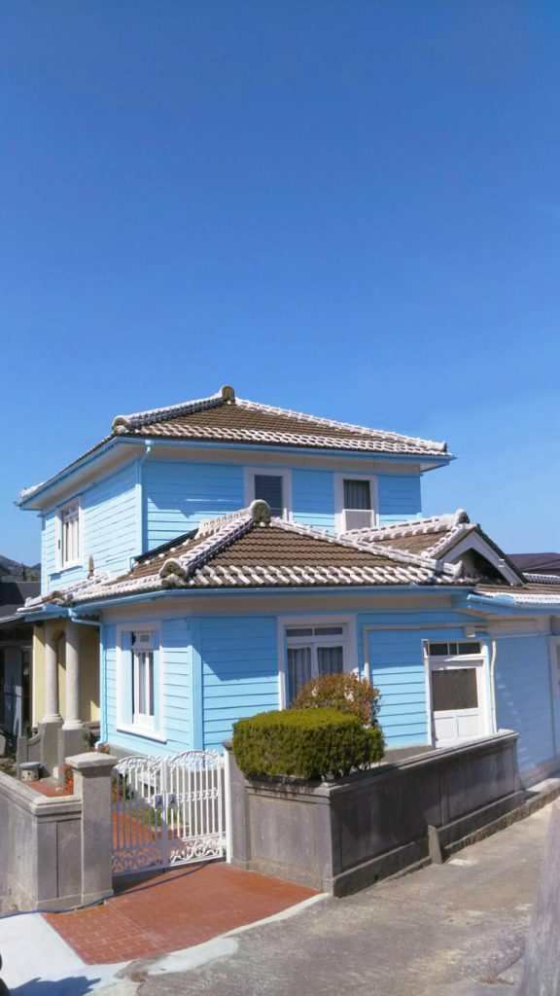
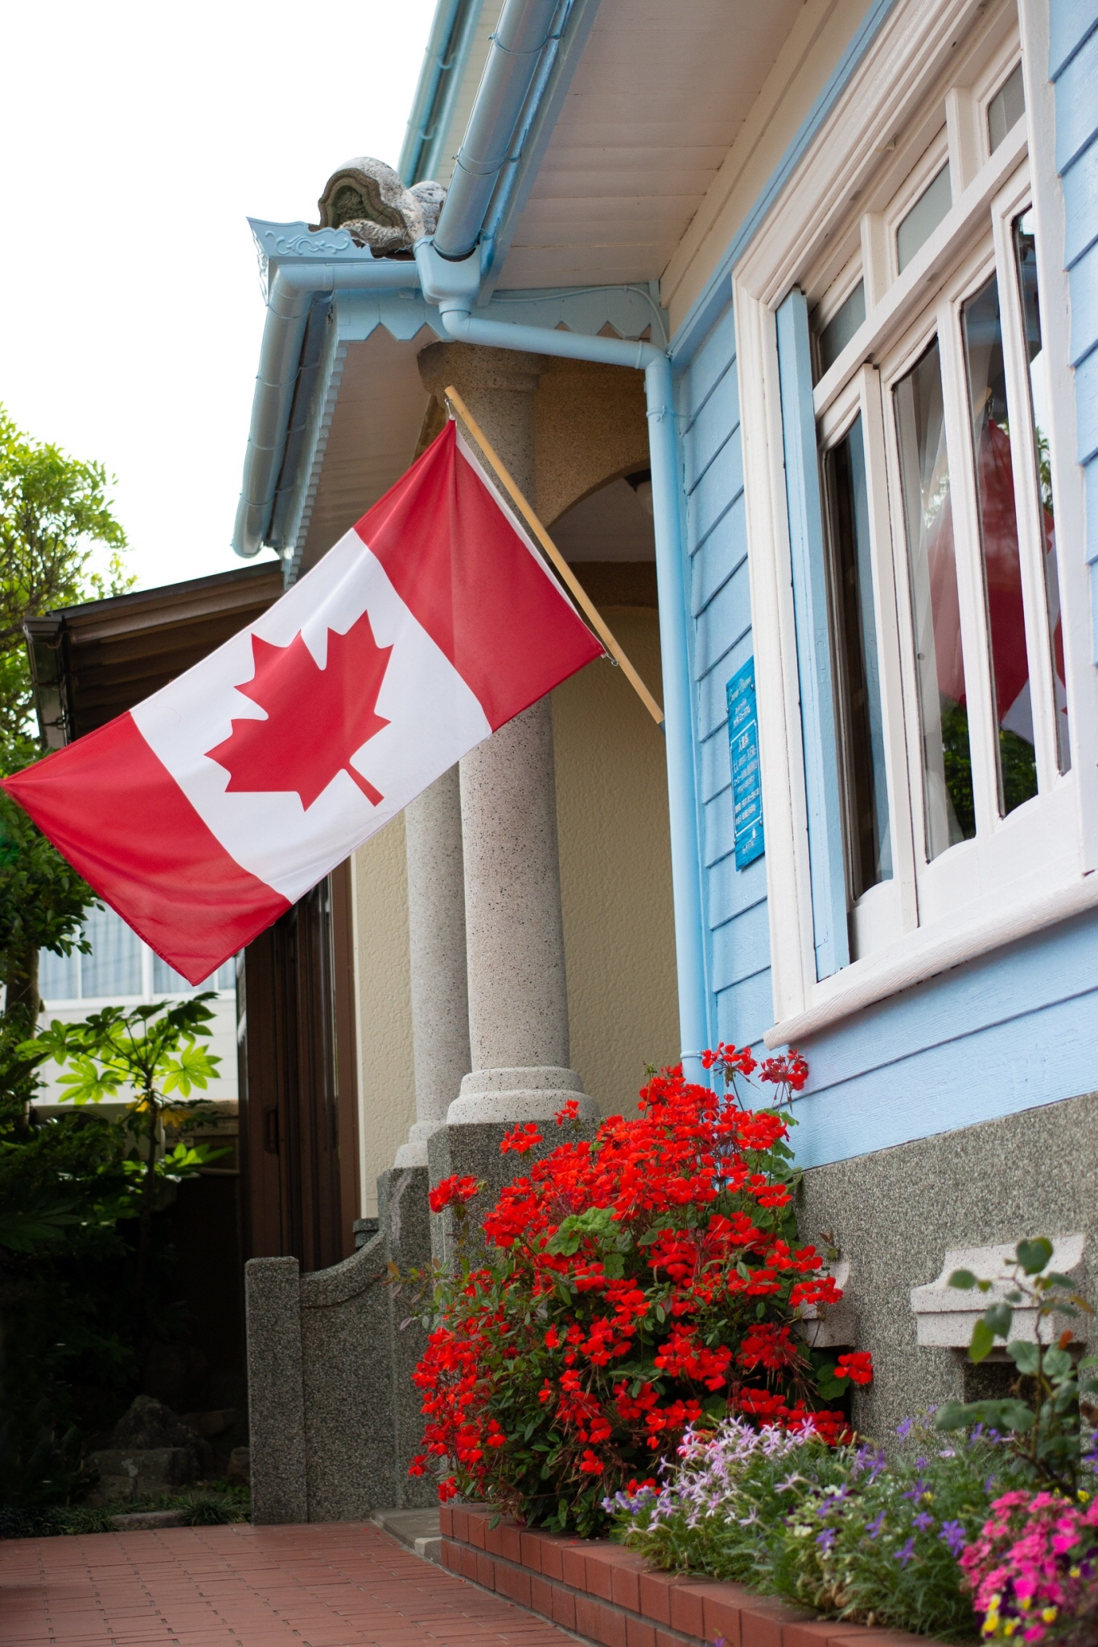
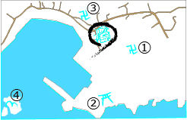
Business hours : 10:00〜16:00
Closed day : Tuesday
During the New Year holidays
Admission fee : Adult ¥150
〜Saw the Dream
Beyond the Ocean〜
Nearby sightseeing spots
① Hozenji Temple ②Ryuo Shrine
③ Komyoji Temple ④Uminekojima Island
Since Meiji era, Mio sent out many villagers to Canada. Some of them returned to Mio with their Canadian lifestyle. This facility was built in a symbolic blending of Japanese and Western-style house to showcase the unique history and culture of Mio, which was formed by the emigrants and their travels to Canada. As a local heritage museum, Canada Museum strives to fill the role of passing on historical artifacts and migration resources to future generations.
Access
From JR Gobo Station, take Gobo Nankai Bus bound for Uminekoｊima and get off at the America-Mura (about 19 minutes).
5 minutes walk from the bus stop
Canada Museum
482 Mio Mihama-cho Hidaka-gun, Wakayama, Japan 644-0045
TEL: +81 738-20-6231 FAX: +81 738-20-6232
Mail : chns04556@gaia.eonet.ne.jp
URL: http://americamura.wakayama.jp
© 2019 Honoka Murakami, Kyoto University of Foreign Studies Proofread by Lisa Domae

Slide 2
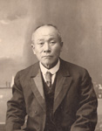
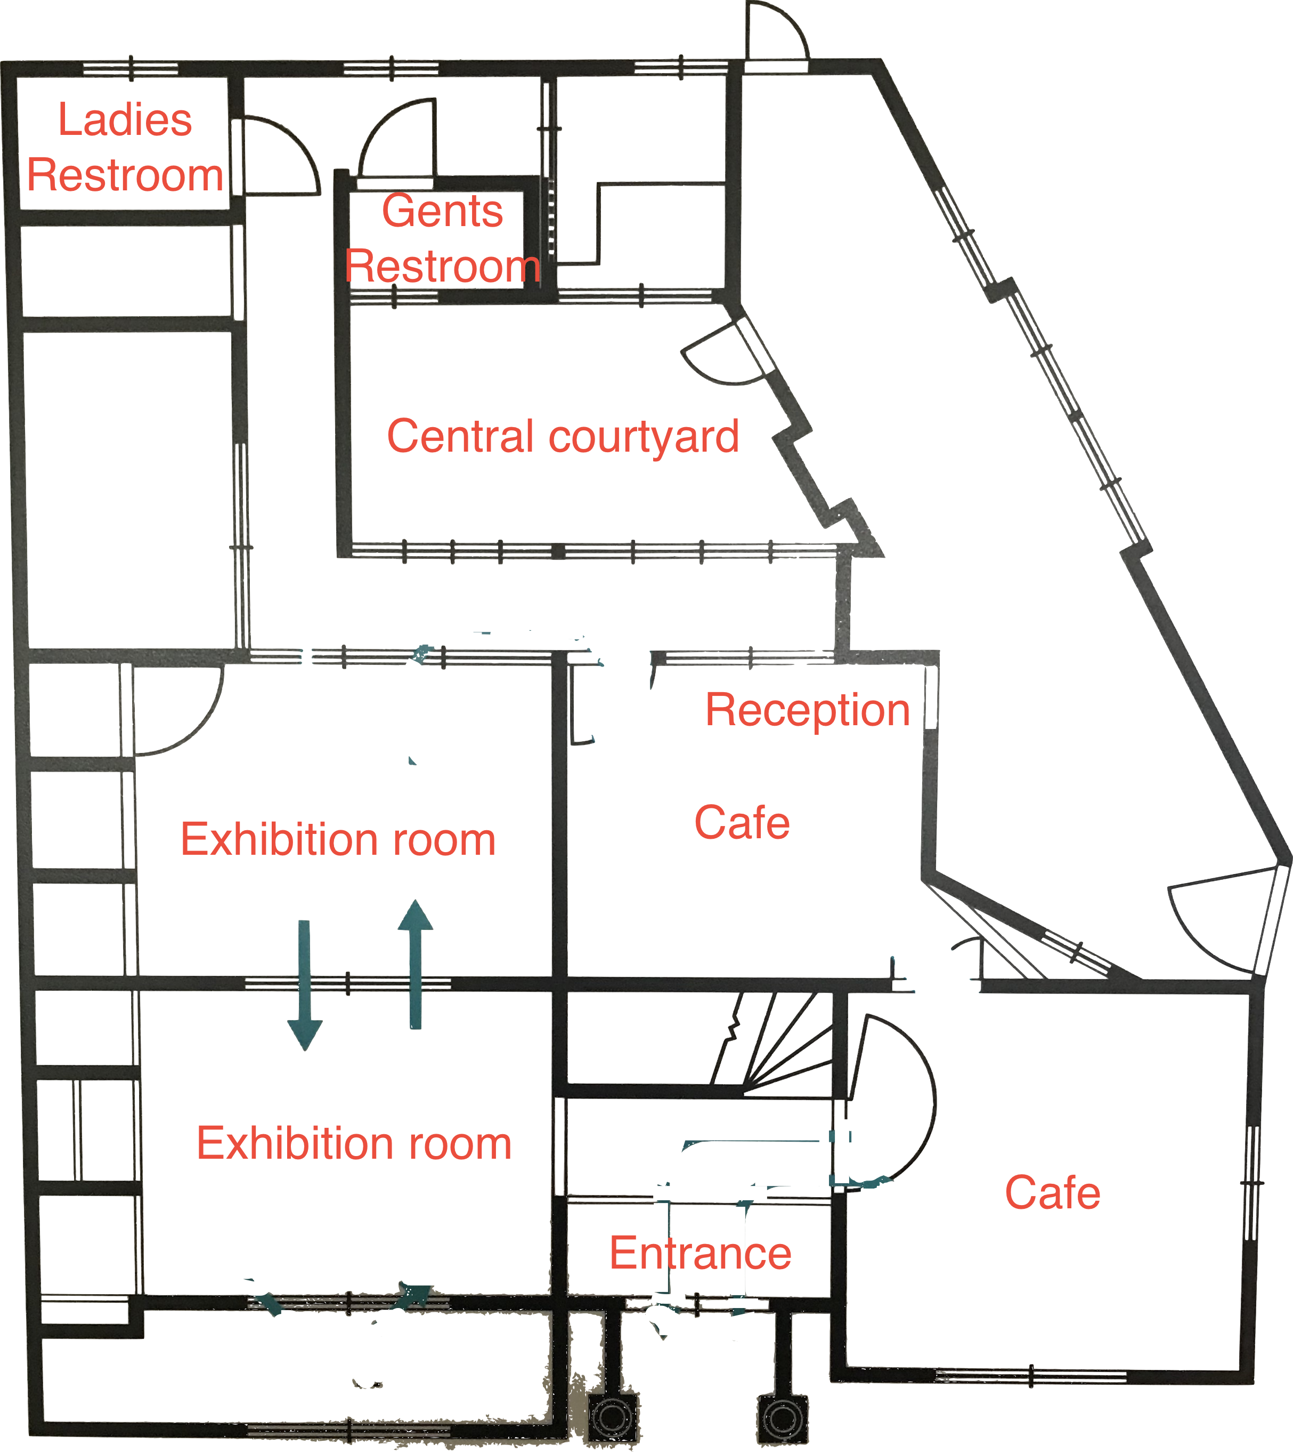
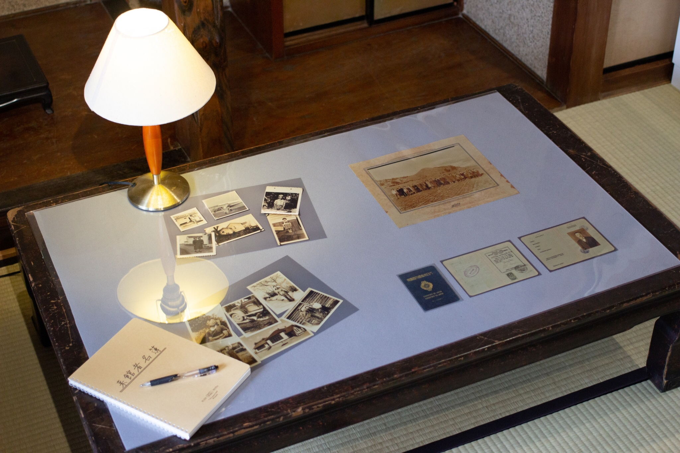
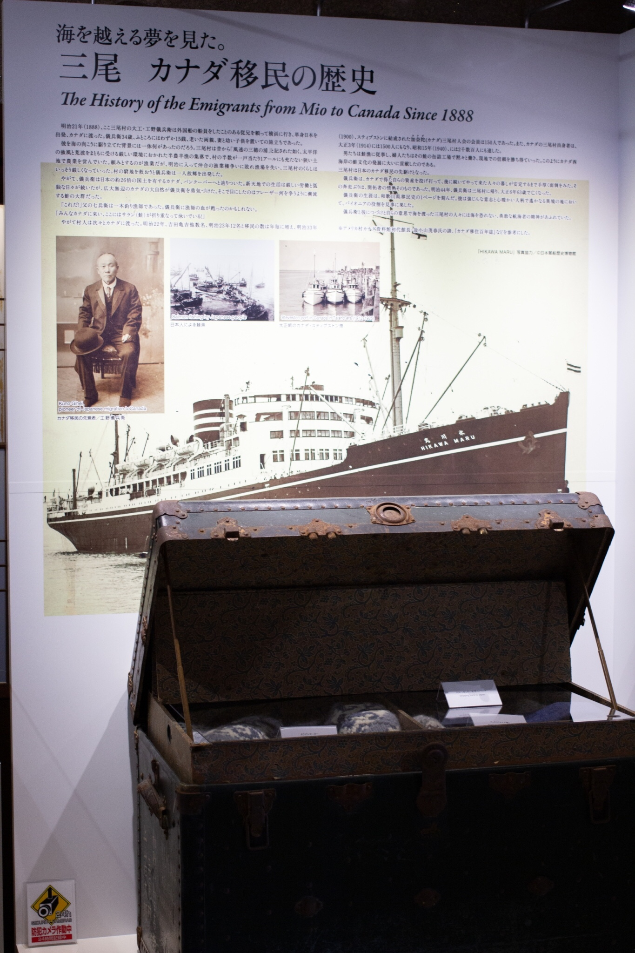
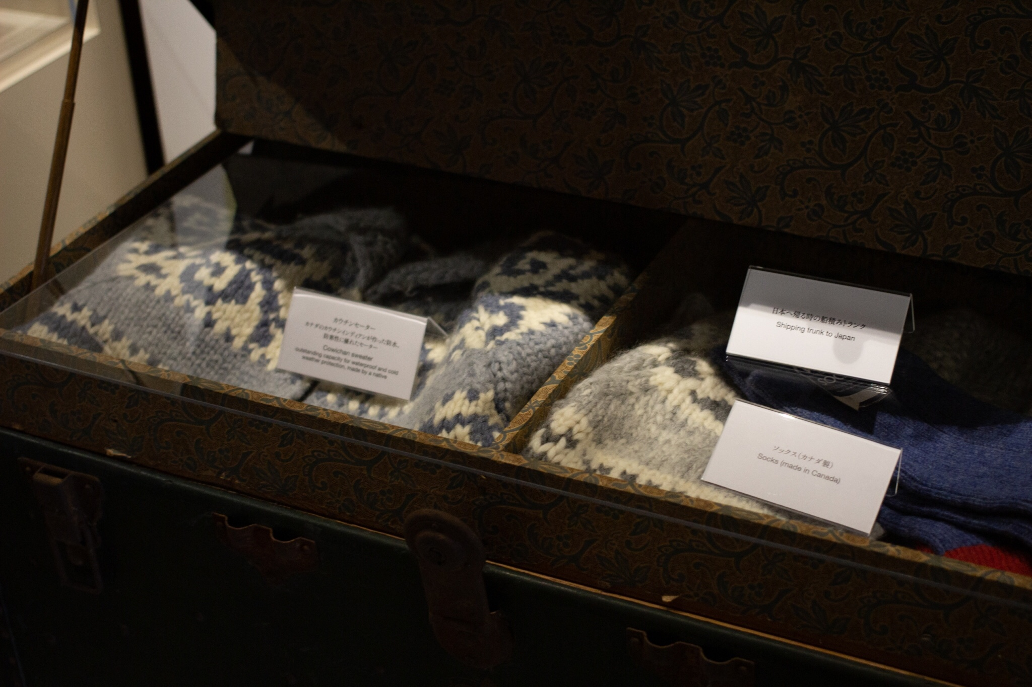
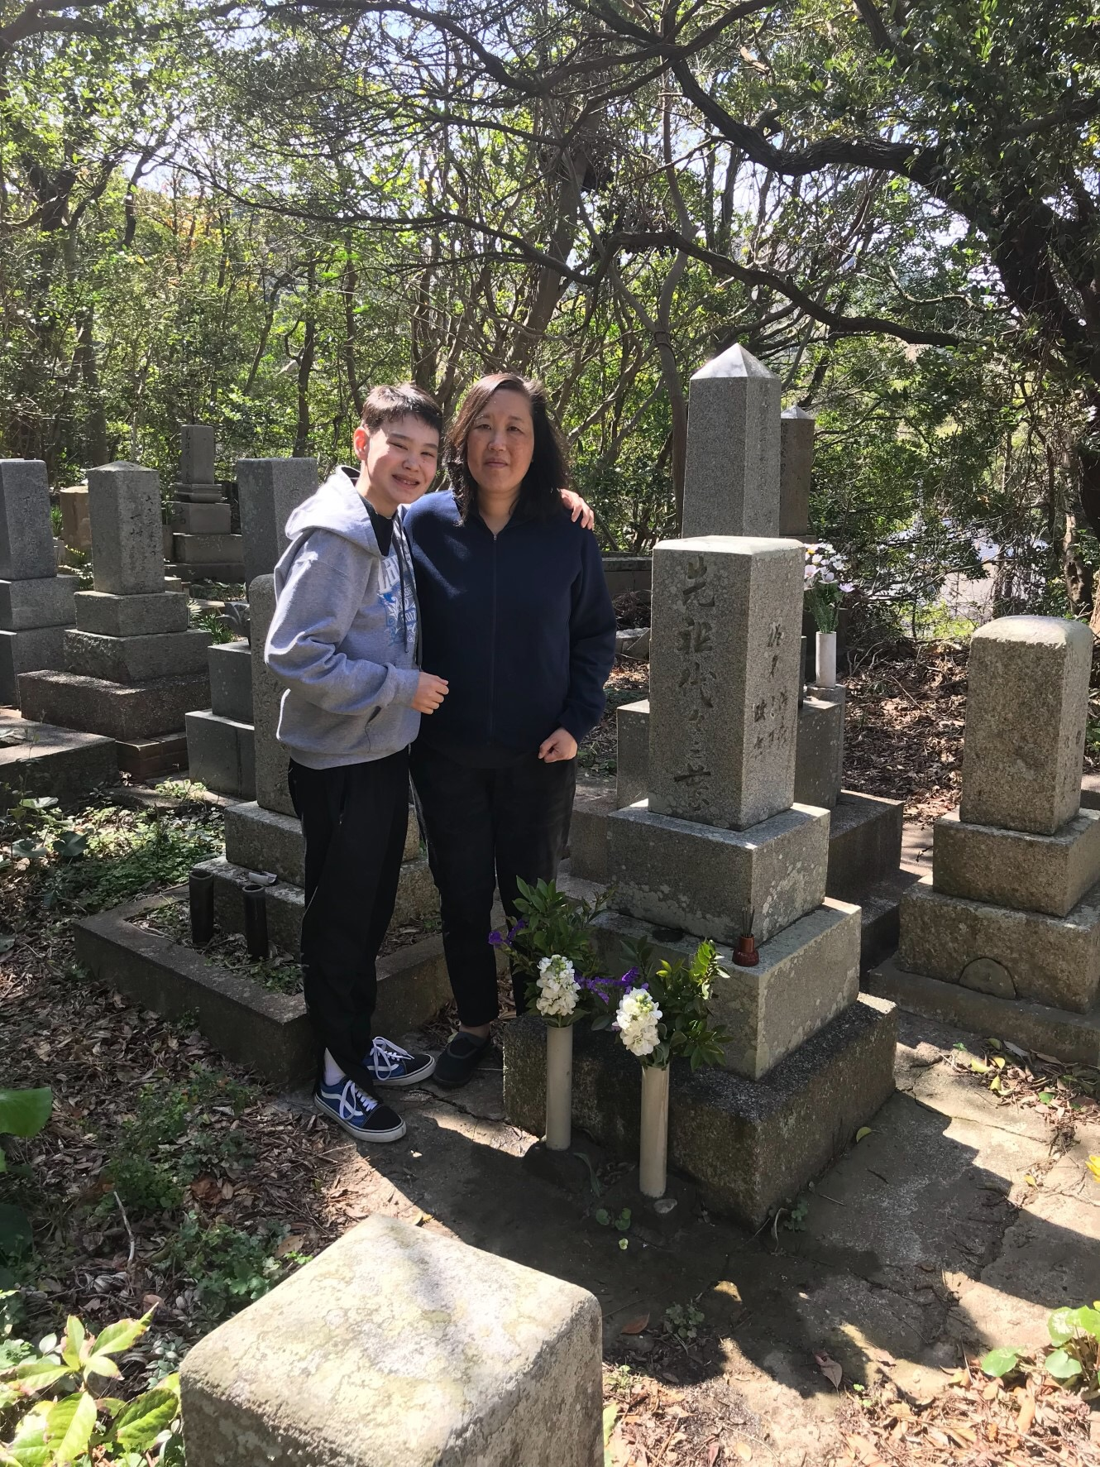
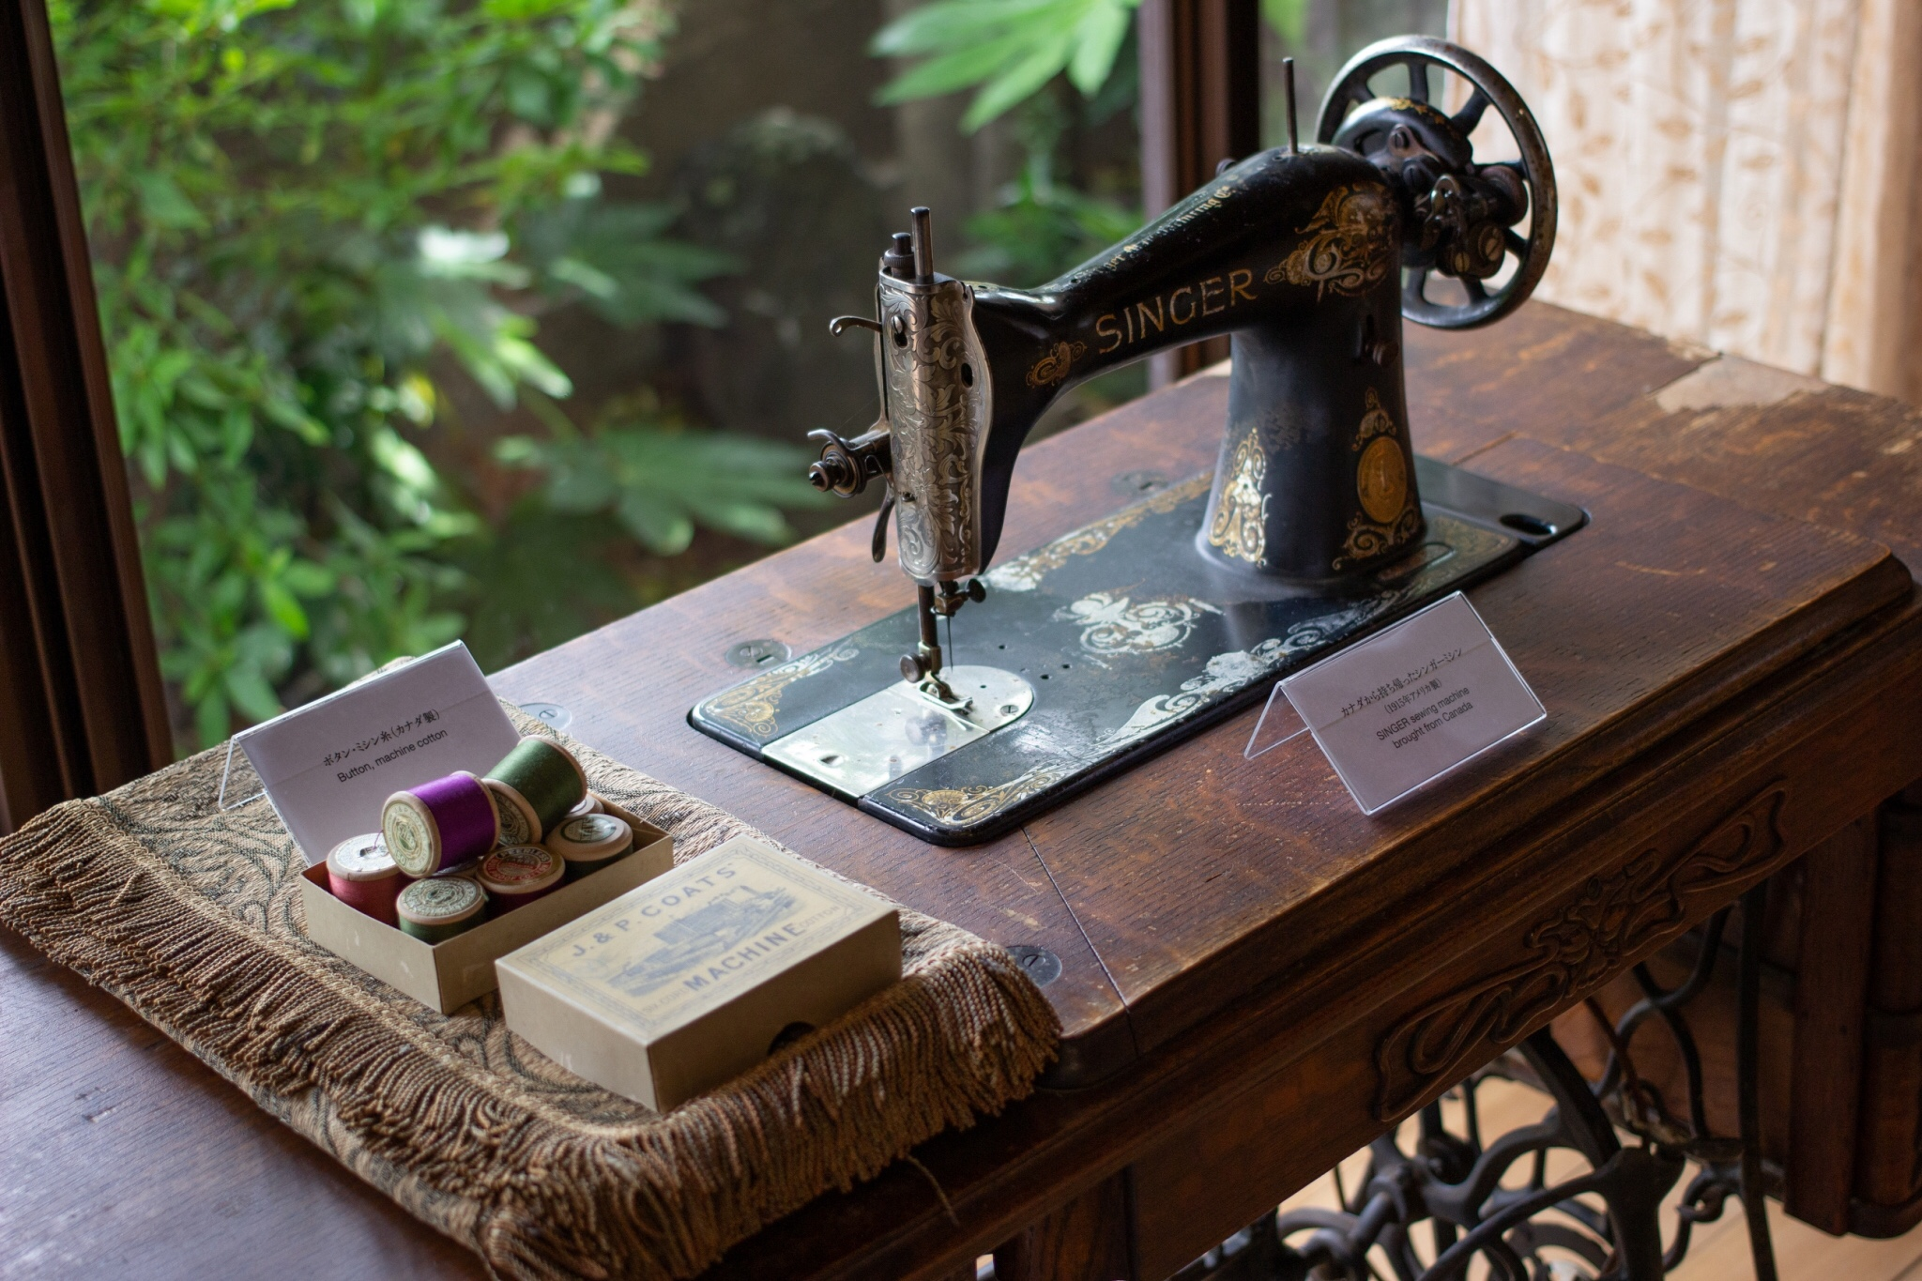
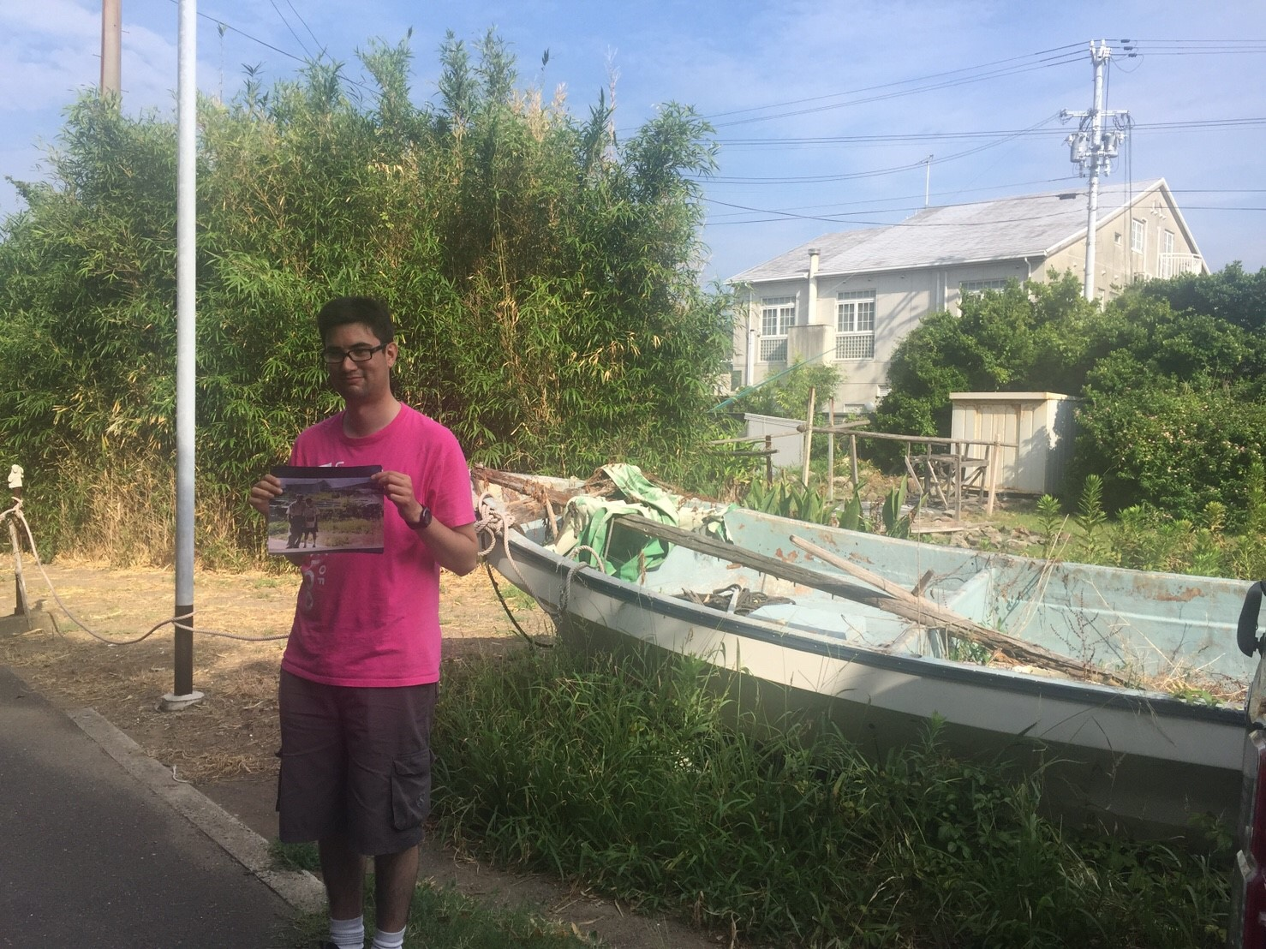
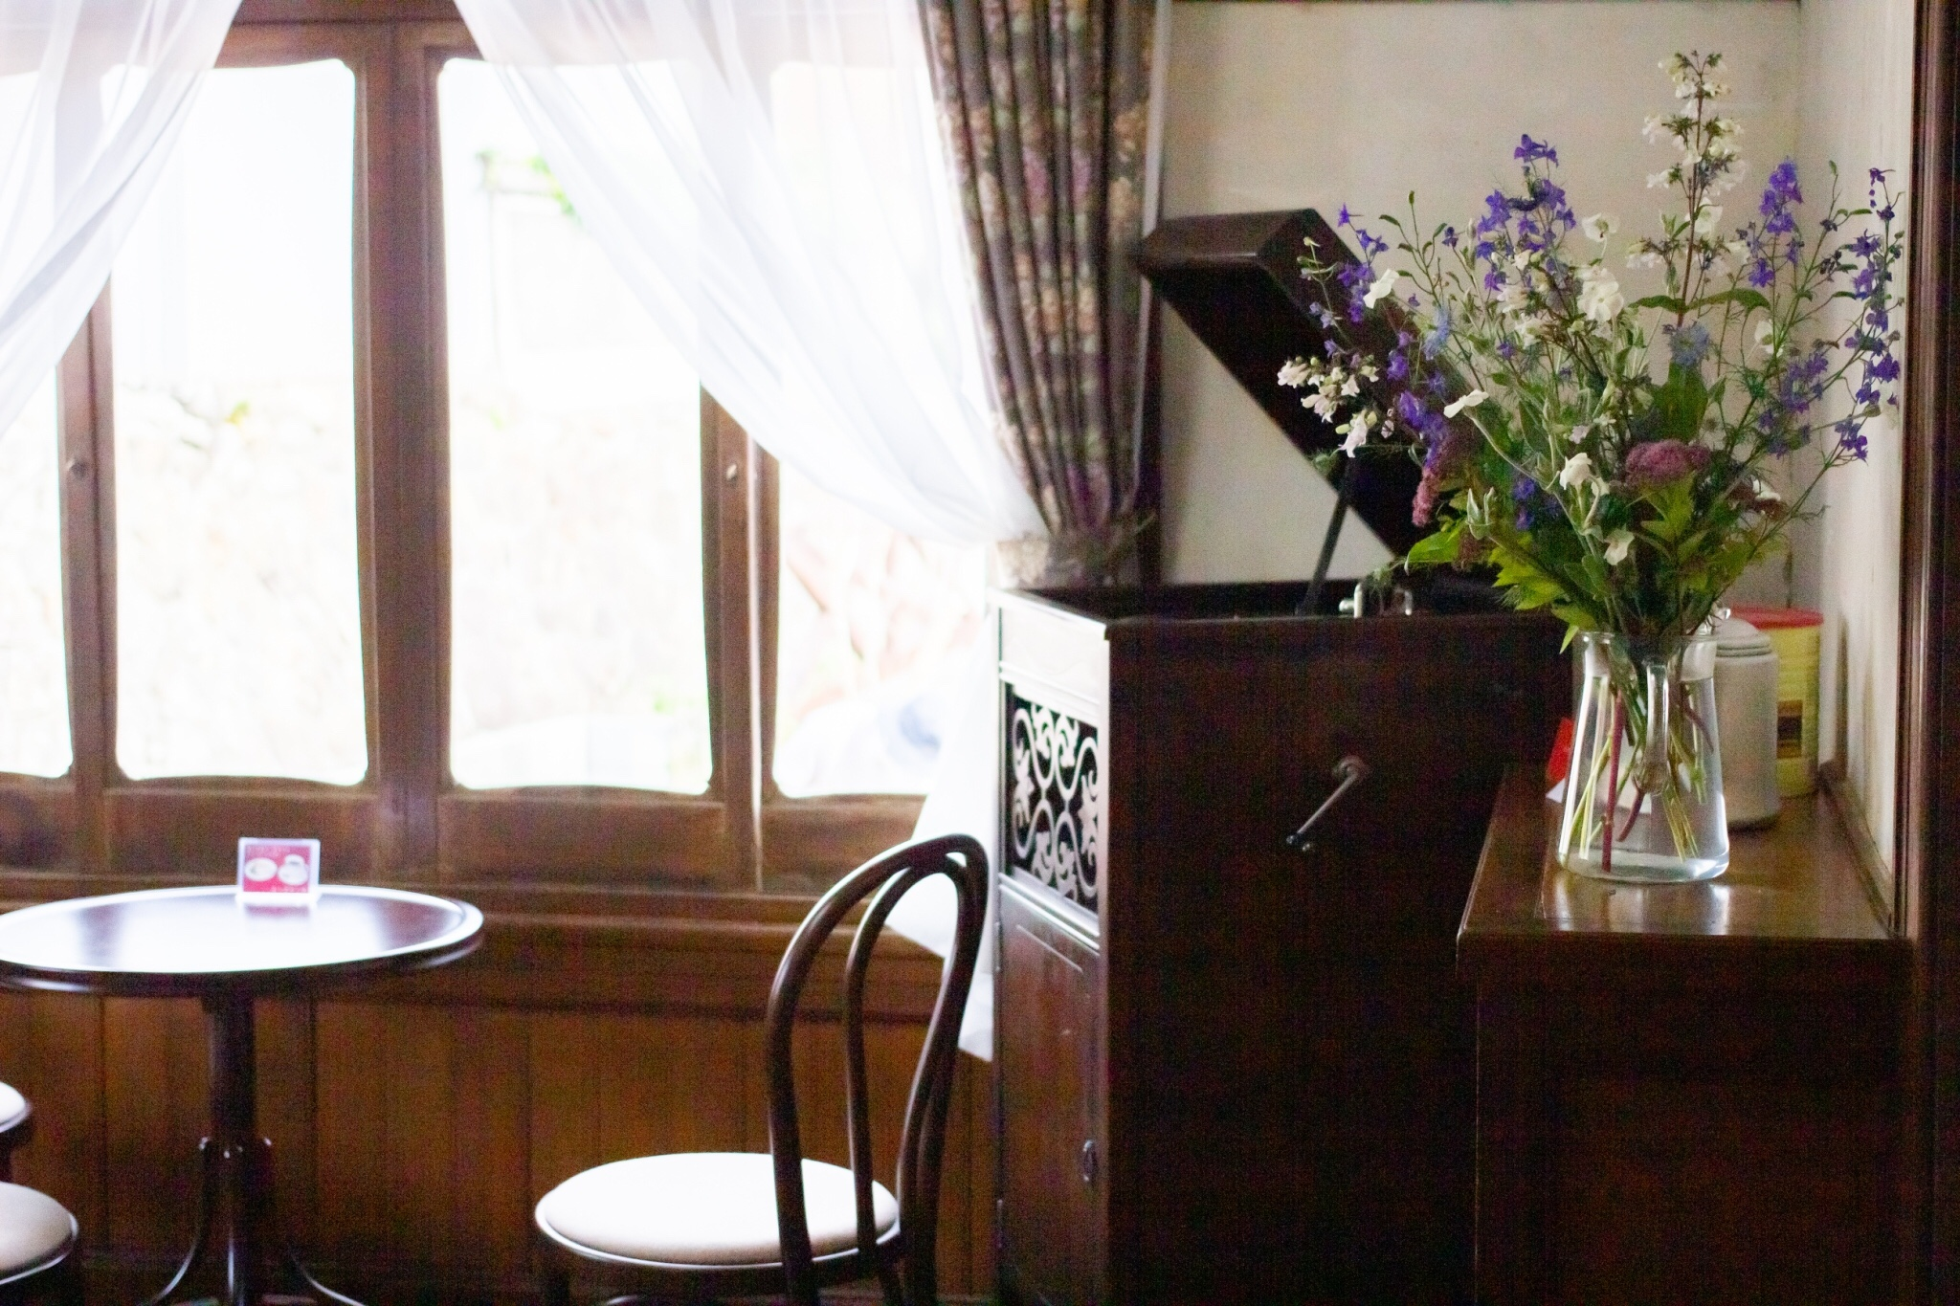
Let’s Study the History of Migrants between Mio and Canada.
Gihei Kuno “ Called Father of immigrants to Canada.”
When he went to Canada, he found vast amounts of salmon in Fraser River. He saw potential for the fishing industry, so he gathered people from Mio with these skills. Recognizing this opportunity, migrants from Mio went to Canada every year.
Let’s trace the Japanese Canadian stories of Mio.
This museum has a visitors sign-in book to record your visit and your memories. Why don’t you leave your memories?
Suguru Noda “Former owner of this house”
He was born in Canada in 1923 and stayed until he came back to Japan in 1928. He returned to Mio in glory, and living in a house there was the ultimate dream for many migrants in those days.
We have resources and information for tracing family routes in Mio. Please contact the museum for more information.
Shipping Steamer Trunk
back from Canada
Find your family’s routes and histories
↑Inside : Cowichan sweater made by the Cowichan Tribes (First Nation). It is great for waterproof and cold protection. For that time, clothes from Canada were expensive and unique in Japan
Sewing machine
brought from Canada
(1915 made in America)
Café Maple
About Architecture in Mio
According to Mio’s records, thanks to the money sent by the family members in Canada, many villagers built new houses or extended their own houses. This brought a great change in scenery of the village. There was a trend to build houses with reinforced concrete, instead of wood, or even to paint the walls of traditional wooden houses. It was a great novelty back then.
Vancouver Asahi
The Asahi was a Japanese Canadian baseball team established in 1914. Tameo Noda who was from this house was inducted into Canadian Baseball Hall of Fame. He was second generation Japanese-Canadian. He was laid to rest in Hozenji temple in Mio and Yasukuni shrine in Tokyo.
Please enjoy a cup of coffee in a space that reflects the lives and experiences of returnees from Canada.

